Slide 1
Control and Loop Structures
By: Iman Khani Jazani
Senior Data Scientist, Community builder | Adin
AI and Data Specialist, Business Developer | AiHum
Adjunct Professor | Sharif University of Technology

Slide 2
Last Lecture
Short Presentation
Review the Last Lecture
What are objects in real world and Python?
What are statements from flowchart view?
Programming with Python
Application of Programming in the Digital Age!

Slide 3

Today
Short Presentation
Review the Last Lecture
What are statements from flowchart view?
Programming with Python
Application of Programming in the Digital Age!

Slide 4
Together
Send your feedback about the class whenever you want!

Slide 5

Contact me
Gmail: ImanKhaniJazani@gmail.com
LinkedIn: https://www.linkedin.com/in/ImanKhaniJazani/
Telegram: @IKJ1992

Slide 6
Grading
راه جبران هم تحت شرایطی وجود داره!
Approx. 25% Programming Assignments (judgment with Quera)
Approx. 14% Mid-term Project (alone, judgment with TAs and Quera)
Approx. 37% Final Project (team work~5 member, judgment with TAs and Quera)
Proposal (about real needs)
Coding
Release
Approx. 30% Final Exam (algorithm-based paper exam)
Approx. 5% Short Presentation(extra score , for the next week lecture, only for the first two person)
Approx. 2% Challenging Questions and Contributions in Class (extra score)
Approx. 7% long presentation (extra score)
Notes:
120 score

Slide 7
Short Presentations

Slide 8
Design and explain a flowchart for a simple Homsa! You can propose new features!
Who is volunteer for the short presentation?
Short Presenration

Slide 9
What is our strategy in class?
BFS 🍕

Slide 10
کوئیز یهویی!
الگوریتم چیست؟ سه معیار را برای کیفیت‌سنجی الگوریتم نام ببرید و در یک جمله هر کدام را توضیح دهید.

Slide 11
Review the Last Lecture

Slide 12
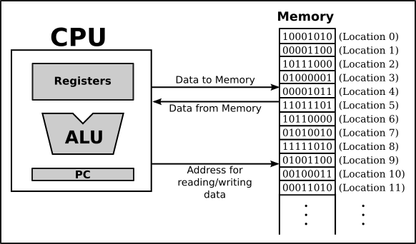
Memory stores information in what way?
Program
Data

Slide 13
So, where is our data???
id(.)

Slide 14
How can CPU process our code?
On the level of machine language, the operation of the CPU is fairly straightforward (although it is very complicated in detail). The CPU executes a program that is stored as a sequence of machine language instructions in main memory. It does this by repeatedly reading, or fetching, an instruction from memory and then carrying out, or executing, that instruction. This process:
fetch an instruction, execute it, fetch another instruction, execute it, and so on forever…
is called the fetch-and-execute cycle.

Slide 15
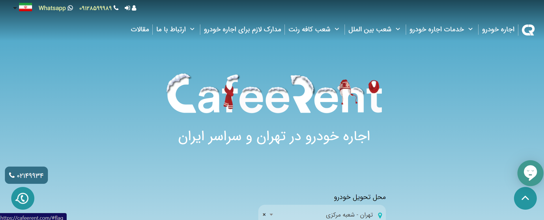
Object-oriented Thinking

Slide 16
Everything in Python is an OBJECT!🙄 OOP!?🤯

Slide 17
What are statements from flowchart view?

Slide 18
The most simple statement!
Assignment
Variables are created by assignment (=)

Slide 19
What is variable?
One of the most powerful features of a programming language is the ability to manipulate variables. A variable is a name that refers to a value.

Slide 20
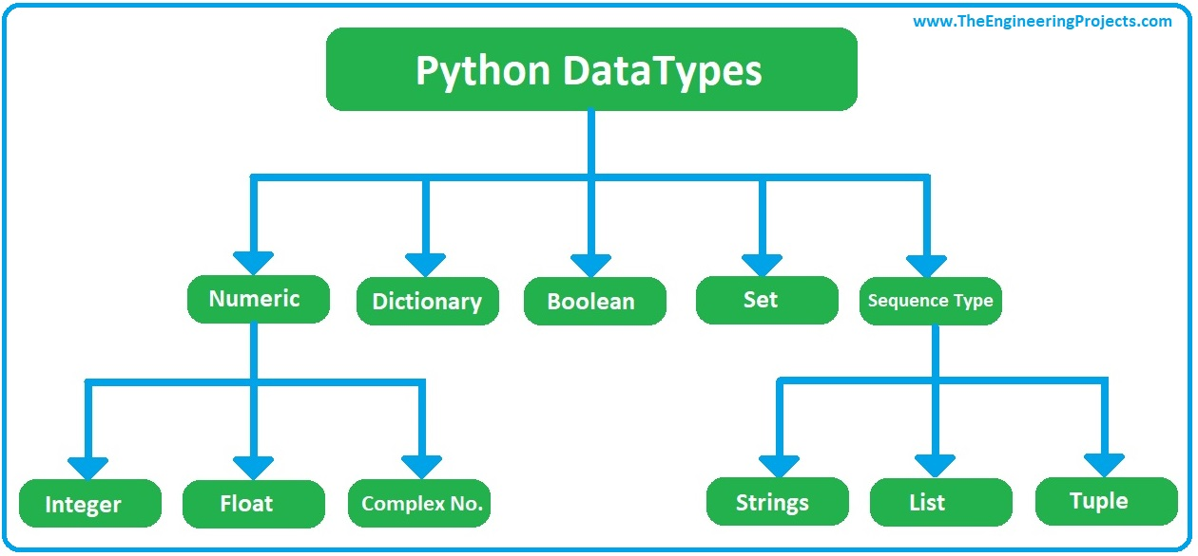
How python can find type of variables?

Slide 21
For Now…
Numeric
Boolean
String
List

Slide 22
Operators in Python
Arithmetic operators
Assignment operators
Comparison operators
Logical operators
Identity operators
Membership operators
Bitwise operators

Slide 23
What is clean code? What is clean code in Python? How can we care it?
Who is volunteer for the short presentation?
Short Presenration

Slide 24
What is the difference between expression and statement?
😵
www

Slide 25
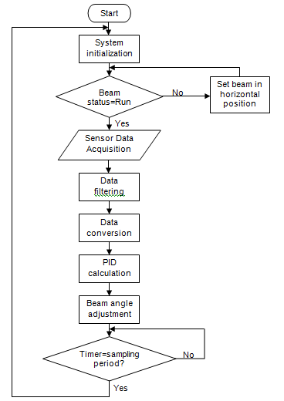
We have different types of statement!
Simple statement (+)
Loop statement (while, for)
Control statement (if, else, elif)

Slide 26
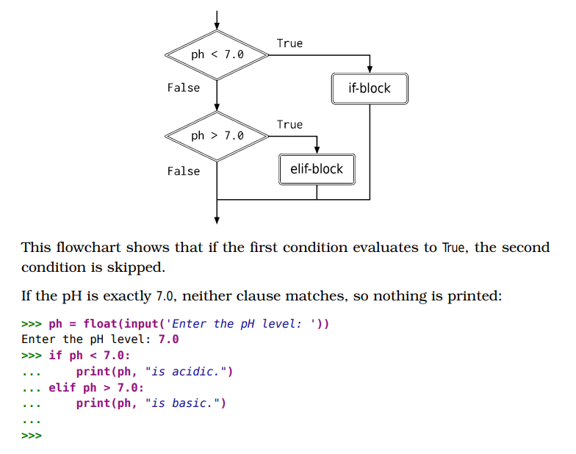
Control statements

Slide 27
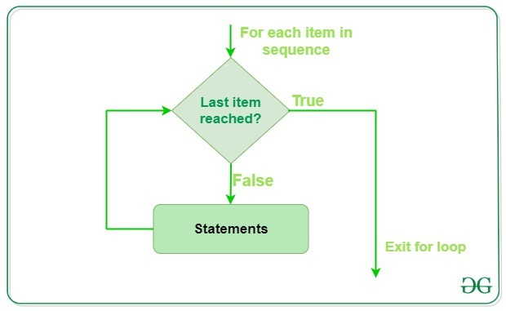
Simple example

Slide 28
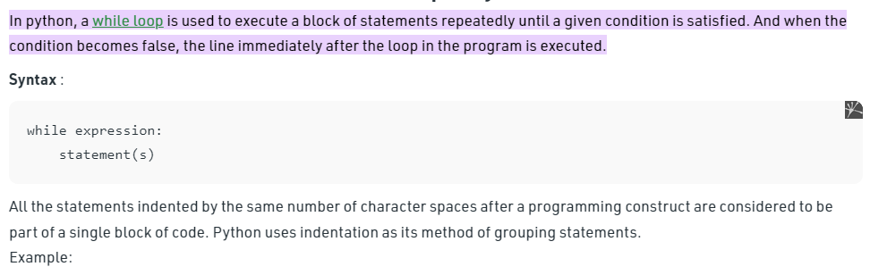
Loop statements

Slide 29
Programming with Python

Slide 30
Question
What is the website need?
How can we get more users for our news website?

Slide 31
From question to algorithm!
Understand your needs or questions!
explain easily for someone else
Decompose your problem (make some steps)!
Make a flowchart for the decomposed version of your problem
Explain each steps in one or two sentences (paper-based or paperless)
input, output, process
Explain each steps mathematically…
Develop your algorithms for each steps
Check your process flow from the first step to the last one!

Slide 32

Let’s go for your solutions and coding with each other😉
Input?
Output?
Process?

Slide 33
Application of Programming in the Digital Age!

Slide 34
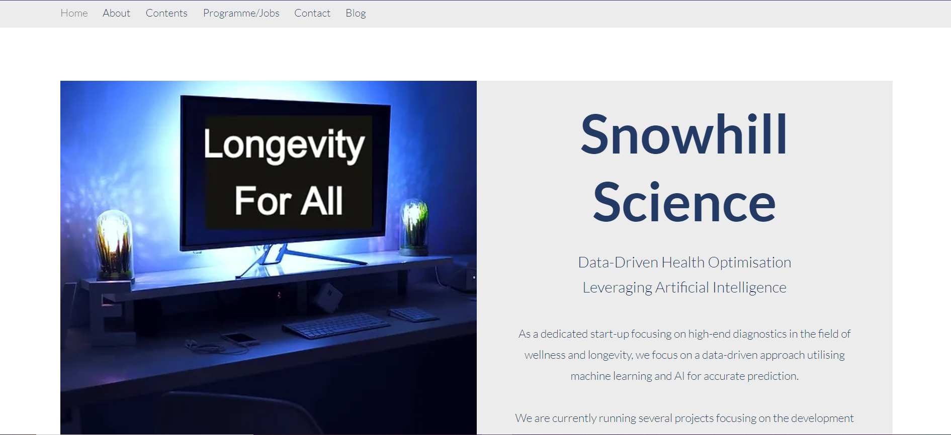
حتی برای مرگ هم دنبال راه حل هستند...!

Slide 35
Lecture Resources
https://www.w3schools.com/python/python_operators.asp
J. Campbell, P. Gries, J. Montojo, G. Wilson. Practical Programming: An Introduction to Computer Science Using Python. The Pragmatic Bookshelf, 2009.
https://www.geeksforgeeks.org/loops-in-python/#:~:text=In%20python%2C%20a%20while%20loop,in%20the%20program%20is%20executed.
https://www.snowhillscience.com/

